Slide 1
Activity 05: Refinement
SISMID Lab
July 22 through July 24, 2026
A Human – AI Teaming Approach to Infectious Disease Modeling

Slide 2

General Housekeeping
Any slide with this icon contains the overview and
expected outputs for the included tasks. All outputs listed on these slides should be uploaded to the course GitHub repository for review.
Any slide with this icon indicates that it is time to complete a hands-on activity. Carefully follow the instructions provided, complete the required task, and verify your results.

Slide 3
Lab Timeline
Activity 1
Activity 2
Activity 3
Activity 4
Data Cleaning &
Visuals
Data
Exploration
Modeling & Forecasting
Evaluation
Activity 5 Refinement
We are here

Slide 4
Task Overviews
Activity | Description
Task 1: Leading Indicators | We will walk through how to incorporate additional data sources into our model using AI. You will choose the source and variable and decide whether to keep it or drop it from the model.
Task 2: Leading Indicators | We will walk through how to incorporate additional data sources into our model using AI. You will choose the source and variable and decide whether to keep it or drop it from the model.
Task 3: Free Coding & FluSight Challenge | We will quickly walk through some set-up rules for FluSight submissions. You will then have some time to free code and work on improving your model. Using your final model, you can submit it to our mini-challenge to see how your model compares to others in the course.

Slide 5
Goal Output
From the three tasks (see previous slide), we should get the below-listed output. By the end of this activity, you should have a completed FluSight model as well as the full pipeline (including the script for this activity; see below) used to build and implement the model.
Activity Output | Description
rules.md | Forecasting rules for Tasks 1 through 3 — leading indicators, changing the model, “FluSight” submission
agents.md | Instructions for the AI assistant (the "agent"). It tells the AI who it is, what job to do, and what rules to follow. You update this file to change how the AI behaves.
scripts/05_improvements.R | R Script that houses all our model changes. The goal is to not overwrite our previous changes, rather try out new things.
YY-MM-DD_NAME_MODEL.csv | Collection of FluSight submission files. We will cover how to achieve these, and the final products will be uploaded to GitHub.

Slide 6
Modeling Process
The modeling process is iterative; you are not going to get it perfect right away.
Our ARIMA forecasts are nowhere near perfect at capturing the truth, even the adjusted non-perfect truth.
We can try different things to improve model performance, using AI to help us implement the changes:
Leading Indicators
An outside signal that rises before admissions do.
Different Models
A different structure: GAM, XGBoost, ensembles, etc.

Slide 7
Task One
Leading Indicators

Slide 8
Leading Indicators
A leading indicator moves before the thing you're forecasting. It climbs or dips weeks ahead of hospital admissions, carrying an early-warning signal the admissions series alone doesn't hold.
Why it can help our models: right now, the model sees only past admissions. A leading indicator feeds it outside information that may anticipate turns the admissions history hasn't shown yet.
Same forecast, more context. We hold everything else fixed and ask one narrow question: does this single extra signal make next week's forecast better?
Please Note: When selecting leading indicators, keep the disease process in mind. What naturally comes before a person gets hospitalized? We want our model to perform well while remaining explainable.

Slide 9
Other Available Data Sources
CDC National Syndromic Surveillance Program
NSSP Emergency Department Visit Trajectories by State and Sub-State Regions (COVID-19, Flu, RSV, Combined). Reports the weekly percentage of emergency department visits attributable to each pathogen, out of all ED visits, for a given state or Health Service Area (HSA). HSAs are groups of one or more counties that align to patterns of care seeking, allowing trends to be viewed below the state level.

Slide 10
Other Available Data Sources
CDC National Wastewater Surveillance System
NWSS Wastewater Viral Activity Levels by National, State, Region, and Site (Influenza A). Reports the concentration of pathogen genetic material detected in untreated wastewater, expressed as a viral activity level relative to a site's historical range and updated weekly. Each site covers a sewershed, the community area served by a wastewater collection.

Slide 11
Examples: Leading Indicators
CDC (NHSN) – Inpatient Admissions | CDC (NSSP) – ED Visits* | CDC (NWSS) – Wastewater**
Total Pediatric Influenza Admissions | 3-week moving average of % ED Visits with a discharge diagnosis of Influenza (percent_visits_smoothed_influenza) | National Wastewater Viral Activity (National WVAL)
Percent Change in the Total Influenza Admissions from Prior Week | % ED Visits with a discharge diagnosis of Influenza (percent_visits_influenza) | -
Number of Adult Influenza Admissions, 18-49 years | - | -
* For additional information on the CDC(NSSP) data set, please see https://cmu-delphi.github.io/delphi-epidata/api/covidcast-signals/nssp.html
** For additional information on the CDC(NWSS) data set, please see https://www.cdc.gov/wastewater/about/data-methods.html

Slide 12
Model Refinement: An Iterative Loop
In infectious disease forecasting, refinement means improving the forecasting system based on what we learn from evaluation.
Diagnose — Where does performance break down? By horizon, season phase, geography, outcome, or uncertainty.
Modify — Make a targeted change to the data, predictors, model structure, or uncertainty estimates.
Refit — Train the revised model using the same forecasting setup.
Re-evaluate — Compare forecasts against held-out observations.
Decide — Keep the refinement only if it improves out-of-sample forecast performance (i.e., in testing period).

Slide 13
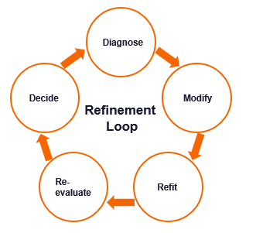

Slide 14
Just as a reminder: We are using the FluSight format for all forecasts.

Slide 15
Column | Description | Entry Type | Acceptable Values
reference_date | The last day of the week the forecast(s) are submitted to the challenge. It is the Saturday following the forecast due date. | ISO Format Date | YYYY-MM-DD
target | The target of the forecast. | Character | wk inc flu hosp
horizon | The number of weeks between the reference_date and the target_end_date. | Numeric | [1]
target_end_date | The last date of the retrospective/nowcast/ forecast target’s week (Saturday). | ISO Format Date | YYYY-MM-DD
location | FIPS codes for U.S. states as well as "US" for national forecasts the corresponding row is associated with. | Character | US
output_type | The type of value shown. | Character | quantile
output_type_id | The quantile label for the value in the corresponding row. | Numeric | 0.01, 0.025, 0.05, 0.1, 0.15, 0.2, 0.25, 0.3, 0.35, 0.4, 0.45, 0.5, 0.55, 0.6, 0.65, 0.7, 0.75, 0.8, 0.85, 0.9, 0.95, 0.975, and 0.99
value | The non-negative numbers indicating the quantile prediction for the corresponding row. | Numeric | Integer

Slide 16
Evaluation: Should we keep the change?
We measure each change against the current model using our Activity 4 evaluation script (Hint: we will include that in our rules to AI for this activity), then decide whether to keep it or revert.
Change | Model | Indicator | WIS | MAE | 95% PI Coverage | Keep?
Baseline | ARIMA | N/A | 4862.8 | 6102.2 | 85% | —
Leading Indicator | ARIMA | National WVAL | [ ] | [ ] | [ ] | [ Y / N ]
Please Note: The metrics shown in the table correspond to the mean metrics at the 3-week horizon. We have selected the wastewater data for this example; feel free to select another option. You will also have time at the end to explore more.

Slide 17
Now it's your turn!
We will work on incorporating one leading indicator together, and there will be time for you to explore a bit more later in the module.
1
Add the ## Leading Indicators header (either prompting AI to add or manually doing it).
We will then prompt Copilot (or AI of your choosing) to incorporate this in the pipeline (i.e., rules, agent, script), while maintaining what we had done before. Rules should include preparing the forecast in the FluSight format (Hint: Activity 3) and producing evaluation results (Hint: Activity 4). Dependent on the prompt of the AI model used, we may get different results. Therefore, its important we check our results to make sure the AI suggestion is methodically valid.
2
3
After updating the rules.md, agents.md, and creating the script, run it and check the results.

Slide 18
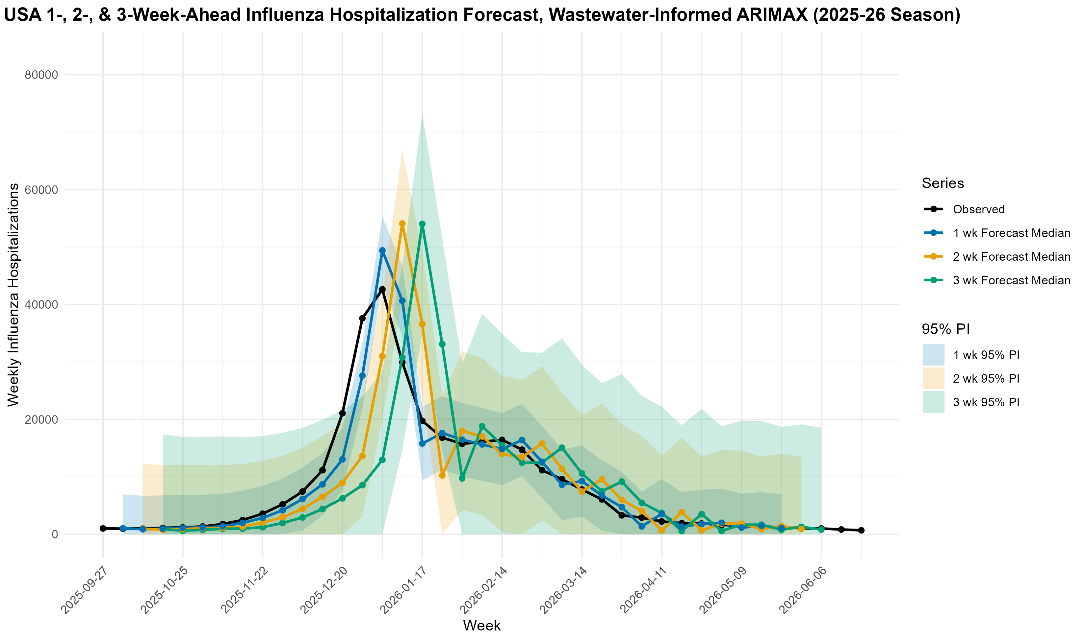

Slide 19
Evaluation: Should we keep the change?
We measure each change against the current model using our Activity 4 evaluation script (Hint: we will include that in our rules to AI for this activity), then decide whether to keep it or revert.
Change | Model | Indicator | WIS | MAE | 95% PI Coverage | Keep?
Baseline | ARIMA | N/A | 4862.8 | 6102.2 | 85% | —
Leading Indicator | ARIMA | National WVAL | 4271.1 | 5407.0 | 91% | [ Y / N ]
Please Note: The metrics shown in the table correspond to the mean metrics at the 3-week horizon. We have selected the wastewater data for this example; feel free to select another option. You will also have time at the end to explore more.

Slide 20
Task Two
Changing the Model Type

Slide 21
Meet XGBoost
XGBoost builds a rough model, sees where it is wrong, and then builds another model to fix those errors. It repeats this a few hundred times, and that process is what we call gradient boosting.
What it is
Short for Extreme Gradient Boosting. A single decision tree is like a game of 20 Questions: it asks simple yes/no questions about the data until it reaches an answer. XGBoost teams up many small trees, each fixing the last one’s mistakes, to make one accurate prediction.
How it learns
Each new tree targets what the current model still gets wrong, and only a fraction of its correction is applied. Learning slowly and in sequence is what keeps the model from overfitting to noise.
Why it shines
It captures complex, nonlinear patterns and feature interactions on its own, copes well with many predictors and missing values, and is consistently a top performer on structured, tabular data.
Notes:
@Lior, added this based on our conversations about adding a machine learning piece. I am not as familiar with this model, so if you see any issues or if this is overcomplicated feel free to make changes!

Slide 22
How XGBoost Works
Boosting adds trees one at a time — each new tree fixes the errors the ones before it left behind.
Tree 1
Makes a first rough prediction.
Tree 2
Corrects Tree 1’s mistakes.
Tree 3
Fixes what’s still left.
Final Prediction
All trees combine.
+
+
=
More trees, sharper predictions — the leftover errors keep shrinking.

Slide 23
Just as a reminder: We are using the FluSight format for all forecasts.

Slide 24
Column | Description | Entry Type | Acceptable Values
reference_date | The last day of the week the forecast(s) are submitted to the challenge. It is the Saturday following the forecast due date. | ISO Format Date | YYYY-MM-DD
target | The target of the forecast. | Character | wk inc flu hosp
horizon | The number of weeks between the reference_date and the target_end_date. | Numeric | [1]
target_end_date | The last date of the retrospective/nowcast/ forecast target’s week (Saturday). | ISO Format Date | YYYY-MM-DD
location | FIPS codes for U.S. states as well as "US" for national forecasts the corresponding row is associated with. | Character | US
output_type | The type of value shown. | Character | quantile
output_type_id | The quantile label for the value in the corresponding row. | Numeric | 0.01, 0.025, 0.05, 0.1, 0.15, 0.2, 0.25, 0.3, 0.35, 0.4, 0.45, 0.5, 0.55, 0.6, 0.65, 0.7, 0.75, 0.8, 0.85, 0.9, 0.95, 0.975, and 0.99
value | The non-negative numbers indicating the quantile prediction for the corresponding row. | Numeric | Integer

Slide 25
Evaluation: Should we keep the change?
We measure each change against the current model using our Activity 4 evaluation script (Hint: we will include that in our rules to AI for this activity), then decide whether to keep it or revert.
Change | Model | Indicator | WIS | MAE | 95% PI Coverage | Keep?
Baseline | ARIMA | N/A | 4862.8 | 6102.2 | 85% | —
Leading Indicator | ARIMA | National WVAL | 4271.1 | 5407.0 | 91% | [ Y / N ]
Model Swap | XGBoost | N/A | [ ] | [ ] | [ ] | [ Y / N ]
Please Note: The metrics shown in the table correspond to the mean metrics at the 3-week horizon. We have selected the XGBoost model for this example; feel free to select another option. You will also have time at the end to explore more.

Slide 26
Now it's your turn!
We will work changing the model together, and there will be time for you to explore a bit more later in the module.
1
Add the # Model Improvements header, and subsequent ## Model Change sub header (either prompting AI to add or manually doing it).
We will then prompt Copilot (or AI of your choosing) to incorporate this in the pipeline (i.e., rules, agent, script), while maintaining what we had done before. Rules should include preparing the forecast in the FluSight format (Hint: Activity 3) and producing evaluation results (Hint: Activity 4). Dependent on the prompt of the AI model used, we may get different results. Therefore, its important we check our results to make sure the AI suggestion is methodically valid.
2
3
After updating the rules.md, agents.md, and creating the script, run it and check the results.

Slide 27
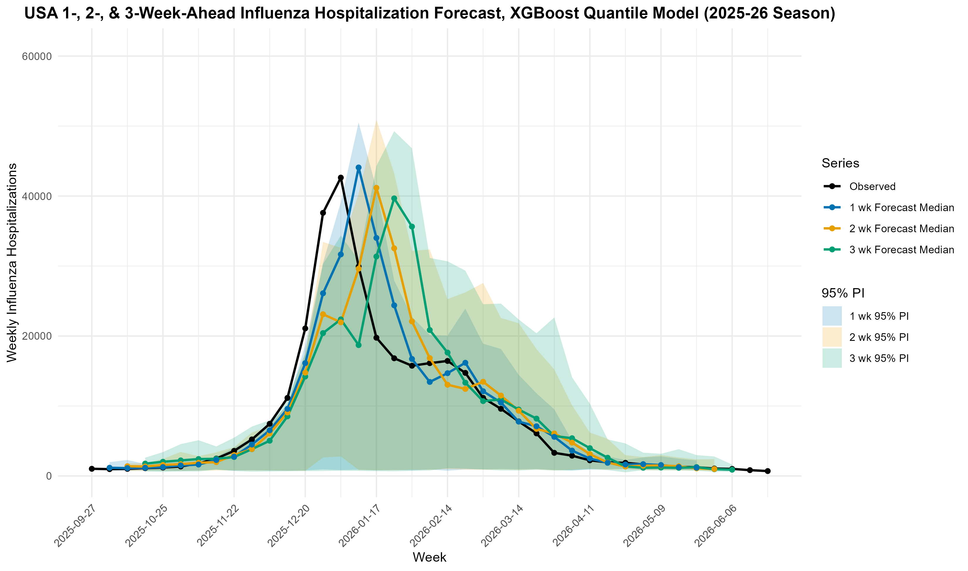

Slide 28
Evaluation: Should we keep the change?
We measure each change against the current model using our Activity 4 evaluation script (Hint: we will include that in our rules to AI for this activity), then decide whether to keep it or revert.
Change | Model | Indicator | WIS | MAE | 95% PI Coverage | Keep?
Baseline | ARIMA | N/A | 4862.8 | 6102.2 | 85% | —
Leading Indicator | ARIMA | National WVAL | 4271.1 | 5407.0 | 91% | [ Y / N ]
Model Swap | XGBoost | N/A | 2634.8 | 4179 | 91% | [ Y / N ]
Please Note: The metrics shown in the table correspond to the mean metrics at the 3-week horizon. We have selected the XGBoost model for this example; feel free to select another option. You will also have time at the end to explore more.

Slide 29
Task 3: Free Coding & Mini-Challenge!
https://github.com/bleicham/Human-AI-Forecasting-Challenge-Sandbox

